Slide 1
STEM Program 2015
BSA troop 222
Penang Malaysia

Slide 2
What is STEM
Science Technology Engineering and Mathematics
To encourage scout interest in STEM
Experience science and mathematics in a fun way
Help scouts get interested in careers in STEM

Slide 3
4 Nova Awards
Shoot
Start Your Engines
Whoosh
Designed to Crunch

Slide 4
Nova Award
Each Nova award has the following components
Watch a documentary and have a discussion
Visit related places
Complete a STEM related merit badge
Do a project

Slide 5
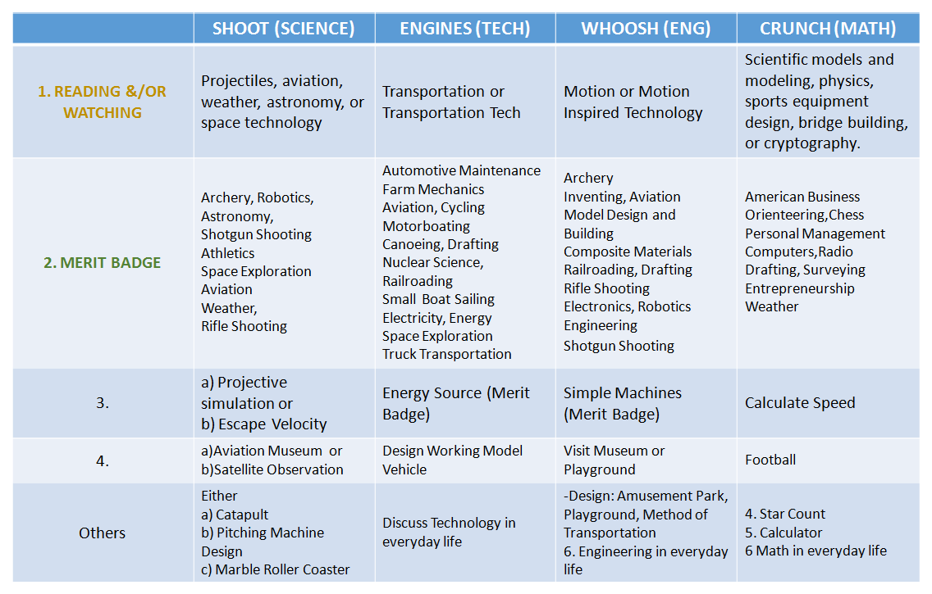

Slide 6
2015 Starting Plan
Interested students sign up
Contact Raj (email – rajp@ni.com)
Start working on the 4 Nova badges
Plan a STEM related activity at Penang Science Cluster

Slide 7
NOVA Counselors
Mr Raj
Mr Chin
Mr Ong
Mr Oppenheim

